Slide 1
Data Structures and Algorithms ( CS1004)
Dr. Jagadeesh Kakarla

Slide 2
Time Table for the Course
CS 1004 - F slot
Monday : 9 – 9:50
Wednesday : 10 – 10:50
Friday : 11 – 11:50
CS 1005 – K and X4 slot
Thursday : 2 to 6 PM
CS + CS-DD (Until 1020) - L 509
CD-DD (From 1021 to 61) + CS-AI – L 512

Slide 3
Course Content
Review of elementary data structures – time and space complexity – step count method based computation – asymptotic analysis and bounds – big oh, little oh, omega, theta notation
Analysis using recurrence relations – solving recurrence relations through guess method, recurrence tree method, master‘s theorem

Slide 4
Analysis of sorting/searching algorithms - Incremental Design - insertion sort, Decremental Design, Divide and Conquer- merge sort, quicksort – comparison/ non-comparison based sorting algorithms on restricted inputs –counting, radix sorting - discussion on inputs with best/worst case complexities
Binary Trees - Tree representation, traversal, Introduction to expression trees: traversal vs post/pre/infix notation. Recursive traversal and other tree parameters (depth, height, number of nodes etc.)

Slide 5
Dictionary: Binary search trees, balanced binary search trees - AVL Trees
Hashing - collisions, open and closed hashing, properties of good hash functions.
Priority queues: Binary heaps with application to in-place sorting
Graphs: Representations (Matrix and Adjacency List), basic traversal such as BFS, DFS with complexity

Slide 6
Essential Reading
M.A. Weiss, Data Structures and Algorithm Analysis in C, Pearson, 2ndedition, 2002.

Slide 7
Grading and Marks distribution
CS 1004
Grading – Relative Grading with Pass Marks 35
Continuous Evaluation : 25 Marks ( Assignment 10, Quiz 15 Marks)
Mid semester Exam: 25 Marks
End semester Exam: 50 Marks
CS 1005
Grading – Relative Grading with Pass Marks 35
Continuous Evaluation : 25 Marks ( Daily Lab Evaluation)
Mid semester Exam: 25 Marks
End semester Exam: 50 Marks

Slide 8
Elementary data structures
A data structure is a way of organizing and storing data in a computer's memory or in external storage devices.
It defines a particular arrangement and organization of data elements to facilitate operations such as insertion, retrieval, and manipulation of data.
What is Linear Data Structure:
A linear data structure is known as a data structure that allows data elements to be arranged in a sequential or linear fashion.
Each element is attached with its next and previous adjacent

Slide 9
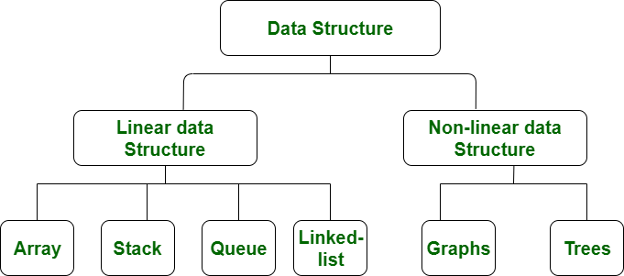
What is Non Linear Data Structure:
Data structures where data elements are not arranged sequentially or linearly are called non-linear data structures.
In a non-linear data structure, single level is not involved. Therefore, we can’t traverse all the elements in single run only.

Slide 10
Linked List:
A linked list is a linear data structure in which elements, called nodes, are connected together via pointers or references.
Unlike arrays where elements are stored in contiguous memory locations, linked lists allow for dynamic memory allocation and more flexible insertion and deletion of elements.
Types of Linked Lists:
Single Linked List
Double Linked List
Circular Linked List
Circular Single Linked List
Circular Double Linked list

Slide 11
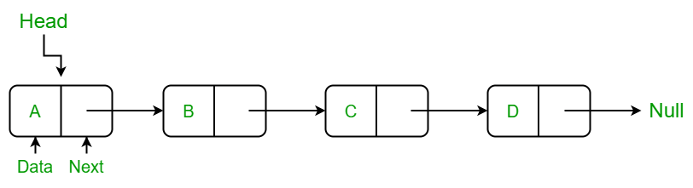
Single Linked List
A singly linked list is a linear data structure in which the elements are not stored in contiguous memory locations and each element is connected only to its next element using a pointer.

Slide 12
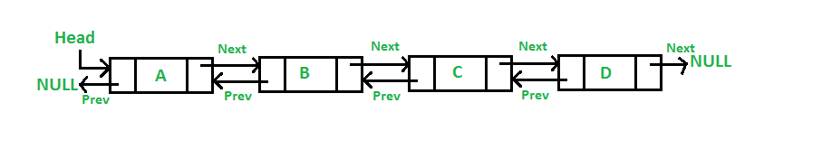
Double Linked List
A doubly linked list (DLL) is a special type of linked list in which each node contains a pointer to the previous node as well as the next node of the linked list.

Slide 13
Circular Linked List
The circular linked list is a linked list where all nodes are connected to form a circle. In a circular linked list, the first node and the last node are connected to each other which forms a circle.

